Slide 1
Small-Scale Activity Observed with GST
Vasyl Yurchyshyn
Big Bear Solar Observatory, New Jersey Institute of Technology
BBSO operation is supported by US NSF AGS-2309939 and 1821294 grant and New Jersey Institute of Technology

Slide 2
An RBE Event as Seen in Hɑ
-0.12 nm -1.0nm -0.08nm -0.06nm -0.04nm -0.02nm
+0.12 nm +1.0nm +0.08nm +0.06nm +0.04nm +0.02nm

Slide 3
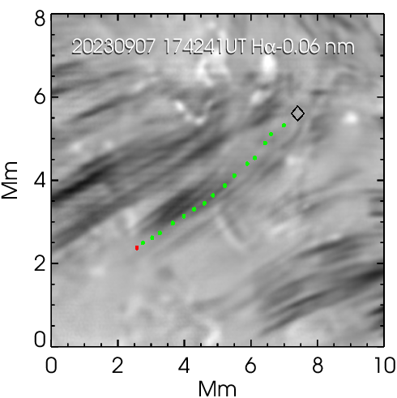
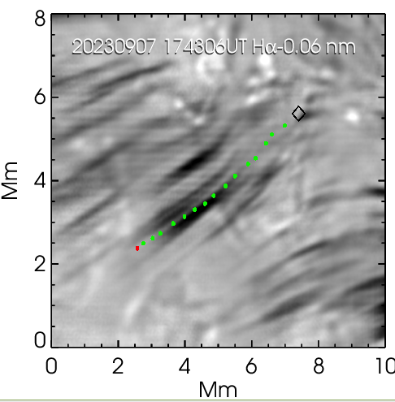
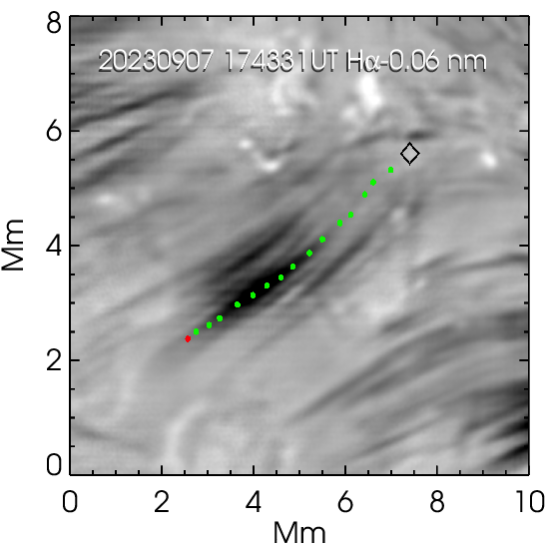
Time Evolution
The RBE does not appear to be extending to the photosphere; It showed some upward extension (~30 km/s) and no downward extension (only very faint traces can be detected in blue-shifted images). The black diamond indicates the inferred starting point and the red dot indicates the endpoint

Slide 4
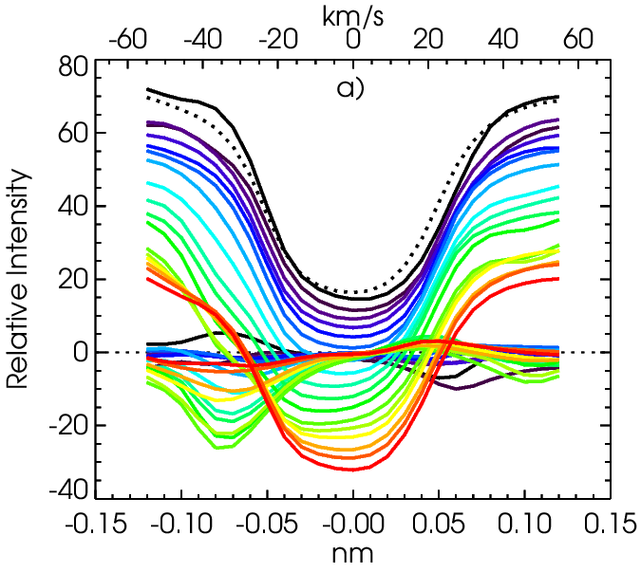
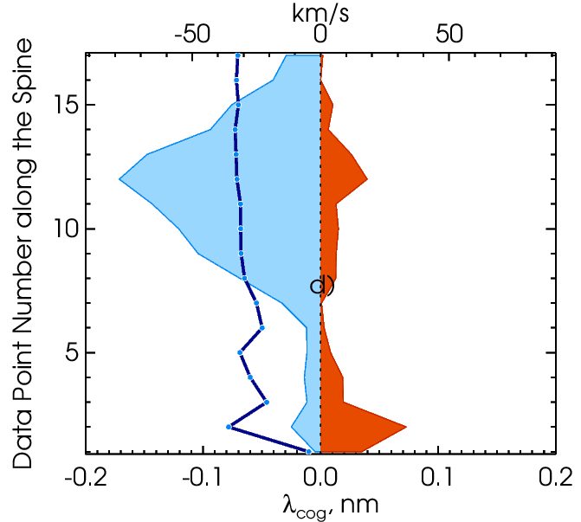
Profile Variations along the Spine of the RBE
Black - RBE start point, red - endpoint; dotted line - average profile; horizontal curves - contrast profile = observed - average
Vertical blue line - COG Speed; Blue/Red shaded area represent the depth of the contrast profile on the blue/red side of the spectral line

Slide 5
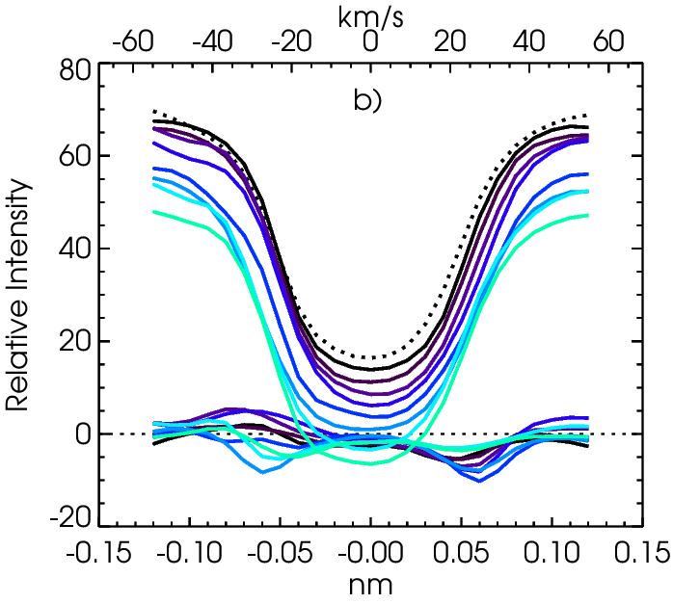
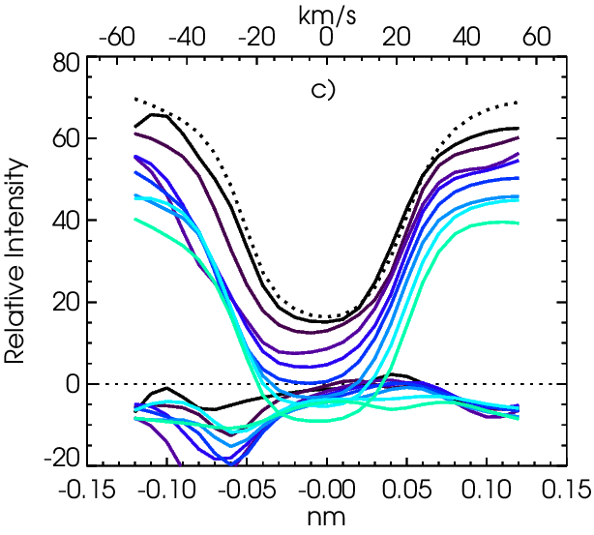
Time Evolution
Time evolution at the start point (black -> green) Note: i) -0.07nm intensity increase at the start of the event; ii) downflows at +0.06nm
Time evolution at middle point (black -> green) Note: variations of the depth of the contrast profile without significant changes in the doppler shift

Slide 6
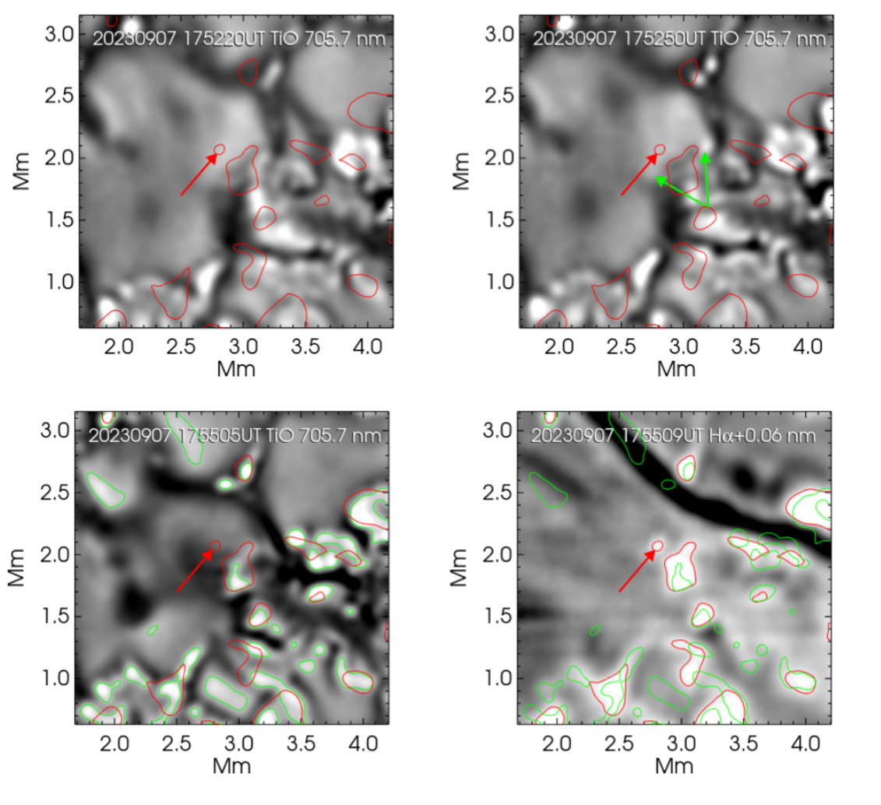
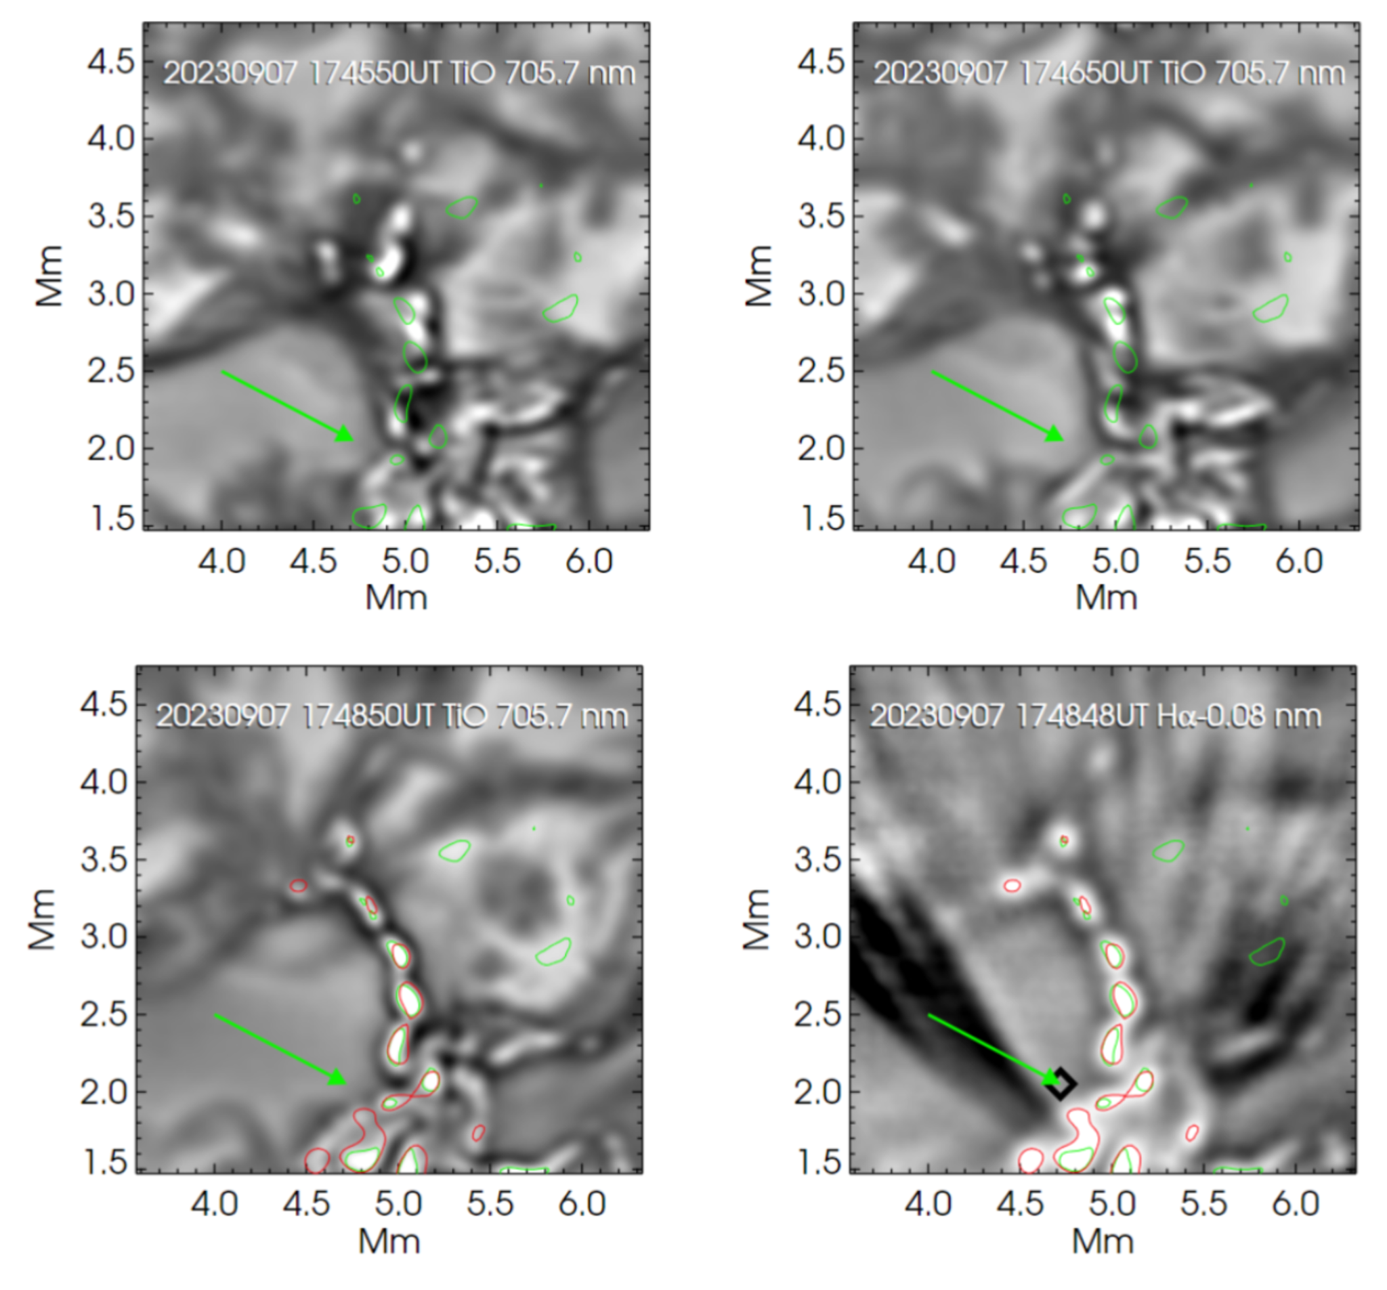
Photospheric Dynamics at RBE Roots
Hɑ-0.06 nm

