Slide 1

Small-scale Dynamo Action in the Quiet Sun : Observational Aspects
Valentina Abramenko
Big Bear Solar Observatory, CA
Email: avi@bbso.njit.edu
Big Bear Solar Observatory
7/05/2011
XXV IUGG/IAGA, Melbourne, Australia

Slide 2
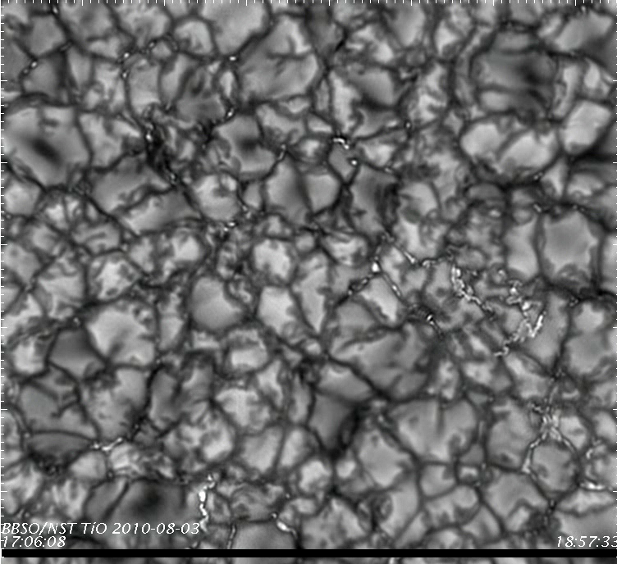
Turbulence is ubiquitous in the photosphere. A question is: are velocities capable
to ensure the increasing, or, al least, non-decreasing magnetic flux?
Notes:
A dynamo process is the magnetic field generation through the motions of electricity conducting medium.
Motions are caused by the turbulent convection in the photosphere and beneath.
Which is clearly demonstrated by observations. (This is high-resolution observations of quiet sun granulations with the new solar telescope of BBSO.)
The Turbulent dynamo operation implies the gradual gain of the magnetic energy inside a volume. In simulations, it is clear how to probe the turbulent dynamo action:
Once you have an initial time for your simulations, you may track the behavior of the magnetic energy accumulated in the volume, and in the case you see the energy increase, you may conclude the dynamo action. Unfortunately, it is impossible to do so when you deal with observation data. You have no start moment, the magnetic energy is constantly generated and dissipated, keeping plasma in a state of dynamical equilibrium. We have to find some approaches to test such a state and to make inferences on possibilities for the dynamo action.

Slide 3
How to explore the turbulent dynamo
from observations?
From kinetic and magnetic energy spectra on small scales
From the structural organization of the magnetic and velocity fields
From diffusivity regime on small scales
7/05/2011
XXV IUGG/IAGA, Melbourne, Australia
Notes:
There should be two approaches suggested.
First, we may test the interplay between the kinetic and magnetic energies behavior - to explore the spatial power spectra of kinetic and magnetic energy.
Second, one might test the structural organization of the magnetic and velocity fields in QS. In particular, their properties of multifractality.
Let us start with the first approach.

Slide 4
Kinetic and Magnetic Energy Spectra
Batchelor 1959
Nakagawa & Priest 1973
Schekochinin+ 2003
Kinetic Spectrum
Power Spectrum
Magnetic Spectrum
wavenumber
Spatial scale
Kinetic dissipation scales , λ _{ν}
Magnetic dissipation scales, λ _{η}
Case of High Prandtl number, Pr= λ _{ν} / λ _{η} >> 1 Small-scale dynamo action is ensured
7/05/2011
XXV IUGG/IAGA, Melbourne, Australia
Notes:
We may start with the interplay between the kinetic and magnetic energies behavior - to explore the spatial power spectra of kinetic and magnetic energy.
This green line represents the spatial power spectrum of the turbulent velocities in the QS photosphere.
The kinetic energy, being deposited into the system at large scales, through the large-scale convective subphotospheric motions, cascades down to smaller scales, producing the Kolmogorov-type spectrum of -5/3. At some (very small) scale , the kinetic vorticies start to dissipate, which results as a cutoff of the spectrum.
One might suggest two possible ways for the magnetic spectrum behavior.
First, the magnetic spectrum is more shallow than the kinetic one, so that
magnetic dissipation starts at very small scales, much smaller than the kinetic dissipation scale.
So that small magnetic eddies can still exist without exhausting at these scales (BOX), whereas kinetic eddies are already dissipates, so they cannot do much to destroy and smear small magnetic eddies.
Small-scale turbulent dynamo action is proved theoretically and in simulations.
This is a case of high Prandtl number.
Batchelor, G.K. 1959, J. Fluid Mech., 5, 113
Nakagawa, Y, Priest, E.R. 1973, ApJ, 179, 949 (smotri ssylki v Boldyrev&Cattaneo 2003)

Slide 5
Kinetic and Magnetic Energy Spectra
Boldyrev and Cattaneo 2003
Iskavov +2007
Pietarila Graham + 2010
Kinetic Spectrum
Power Spectrum
Magnetic Spectrum
Magnetic dissipation
scales, λ _{η}
wavenumber
Spatial scale
Kinetic dissipation scales , λ _{ν}
Case of Low Prandtl number, Pr= λ _{ν} / λ _{η} <<1 Small-scale dynamo action is questionable
7/05/2011
XXV IUGG/IAGA, Melbourne, Australia
Notes:
Another case (low Prandtl number case) is when magnetic dissipation starts at much larger scales, which are even larger than the kinetic dissipation scales. Here, the turbulent dynamo action is very problematic, at least, at very small scales (just because these small magnetic eddies cannot survive).
There are numerical simulations which show that the turbulent dynamo is possible (under additional suggestions) in the case of small Prandtl number:
Pietarila Graham + 2010
Boldyrev and Cattaneo 2003
Iskavov +2007
So, it seems to be useful to see how the real kinetic and magnetic spectra behave in the QS photosphere.

Slide 6
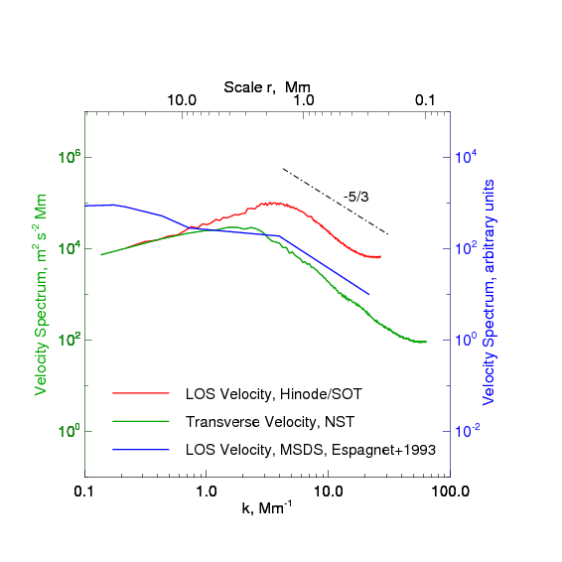
Kinetic and Magnetic Energy Spectra
Observed Velocity Spectra
7/05/2011
XXV IUGG/IAGA, Melbourne, Australia
Notes:
This are velocity spectra from observations.
Blue line – Peak du Midi observations with resolution of 0.8 arcsec (Espagnet et al. 1993 AA271).
Red – Doppler velocities from Hinode SOT in the line v1=6301A (2008 03 10, QS).
Green – transverse velocity from NST observations of the solar granulation in QS, pixel size 0.0375 arcsec and dif limit of 0.1 arcsec (2009 Jul 29 TiO , ref na Goode +2010).
All the spectra show a maximum at 1.5-2 Mm subsequent with a Kolmogorov-type decrease.
The dissipation scale (a break to the steeper slope) is not observed. Apparently, the viscous dissipation scale is very small and below the resolution limit of the modern telescopes.

Slide 7
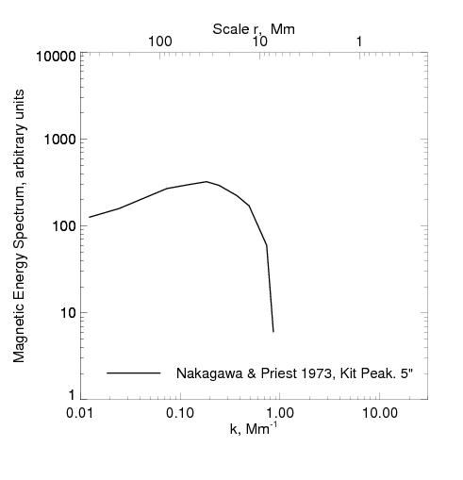
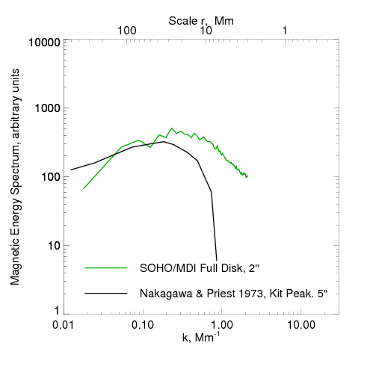
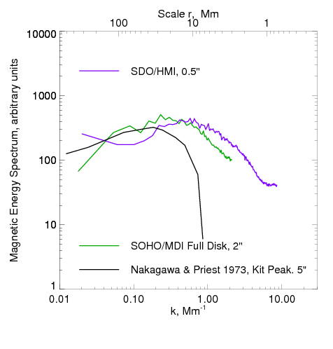
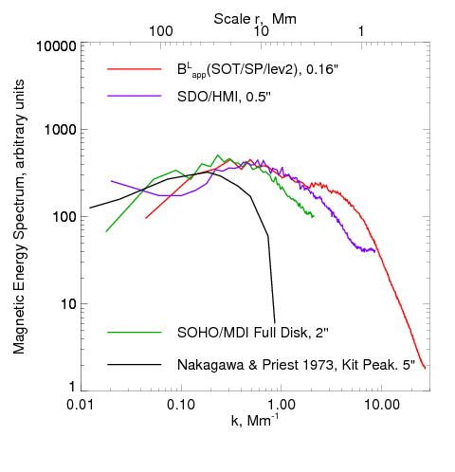
Kinetic and Magnetic Energy Spectra
Observed Magnetic Spectra
_{-1/3}
7/05/2011
XXV IUGG/IAGA, Melbourne, Australia
Notes:
What we have for the magnetic spectra?
Black line is the very old result, the power spectrum of the magnetic field in QS. Kit Peak data with 5 arcsec resolution were used by Nakagawa and Priest (1973,ApJ 179, 441). The spectrum saturates at scales of about 20 Mm.
Next, the MDI FD data (green) saturates at scales about 10 Mm. The steeper slope below 10 Mm might be an energy cascade signature, However, observations with higher resolution (purple line, HMI data) demonstrate an extension of the shallow magnetic spectra toward smaller scales, down to 4-5 Mm.
And observations with Hinode/SOT show that the magnetic spectrum extends with the same slope of about -1/3, down to 1.5 Mm scale.
The behavior essentially different from that we saw for the velocity spectra.
So, we may presume that further observations with better resolution might easily show the more extended shallow magnetic spectrum, which could follow this dashed line.

Slide 8
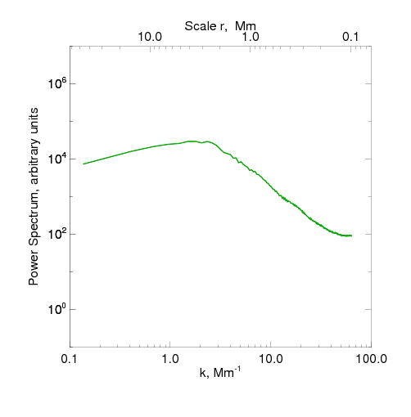
Kinetic and Magnetic Energy Spectra
Comparison
7/05/2011
XXV IUGG/IAGA, Melbourne, Australia
Notes:
Being compared to the velocity spectrum, the dashed line location can ensure a possibility for prevalence of magnetic energy over the kinetic energy at small scales, High Prandtl number conditions, and which means the turbulent dynamo action.

Slide 9
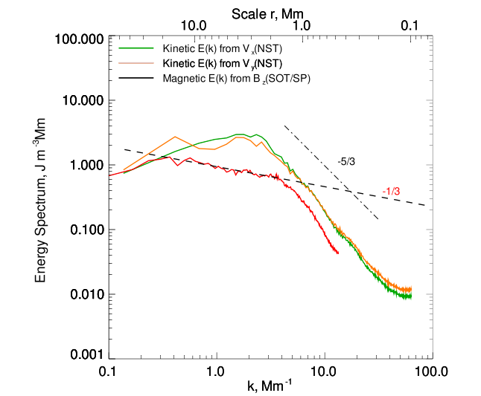
Kinetic and Magnetic Energy Spectra
Comparison
λ_{η} ?
λ_{η} ~ η^{3/4} = K^{3/4}
7/05/2011
XXV IUGG/IAGA, Melbourne, Australia
Notes:
Plotted for real data this figure will look this way:
Indeed, at scales below 1 Mm we might expect the turbulent dynamo action.
How far the magnetic spectrum will be extended to the right, depends on the magnetic turbulent dissipation scale (NEXT)

Slide 10
Kinetic Spectrum
Power Spectrum
Magnetic Spectrum
Magnetic
Spectrum
Wavenumber
Spatial scale
λ _{η}
λ _{ν}
λ _{η}
λ _{η} = ε^{1/3} η^{3/4} ~ K^{3/4}
Magnetic dissipation scale varies in direct proportion
yo the coefficient of magnetic turbulent diffusion
7/05/2011
XXV IUGG/IAGA, Melbourne, Australia
Notes:
…lambda eta, which, in turn, is in direct proportion with the magnetic turbulent duffusivity , eta, in another notations, K.
Actually, we can estimate the magnitude and scale-related tendency for K from observation.

Slide 11
Diffusivity Regime on small Scales
7/05/2011
XXV IUGG/IAGA, Melbourne, Australia
Notes:
The NST high res observations of BPs dynamics are very useful for this goal.

Slide 12
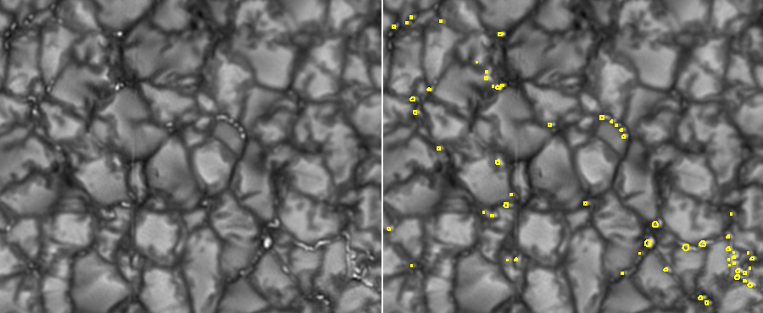
Bright points detection
Detection criteria: lifetime longer than 20 s;
area larger than 2 pixels;
brightness above the mean image brightness.
Total: 13597 tracked BBs for th=85 DN
7148 tracked BPs for th=120 DN
7/05/2011
XXV IUGG/IAGA, Melbourne, Australia

Slide 13
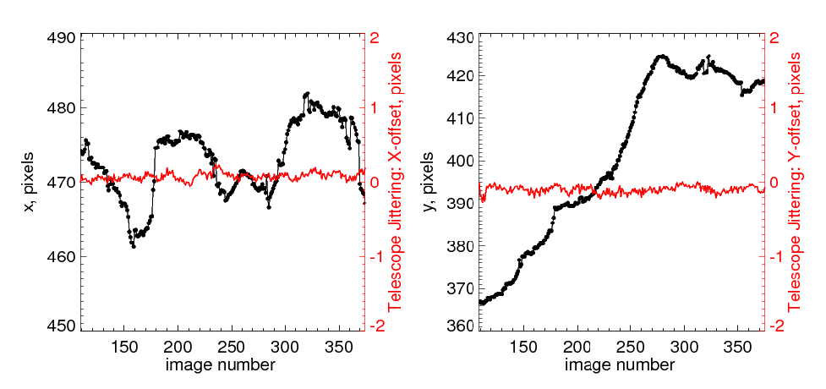
Trajectory coordinates measurements (black) vs
residual jittering of the telescope (red)
Max jittering: 0.2 pixel = 0.2 x 0.0375” = 5.4 km on the solar surface
7/05/2011
XXV IUGG/IAGA, Melbourne, Australia

Slide 14
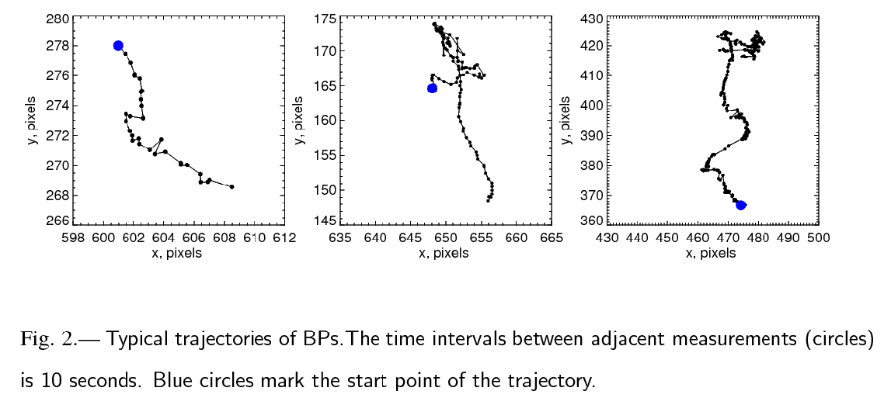
Trajectories of BPs
﻿This is placeholder copy
﻿This is also placeholder copy
Typical examples of BPs trajectories. Time intervals between adjacent circles
is 10 s. The blue large circles mark the start points of the trajectories.
For each tracked BP, the average diameter was calculated.
Big Bear Solar Observatory
7/05/2011
XXV IUGG/IAGA, Melbourne, Australia
Notes:
14

Slide 15
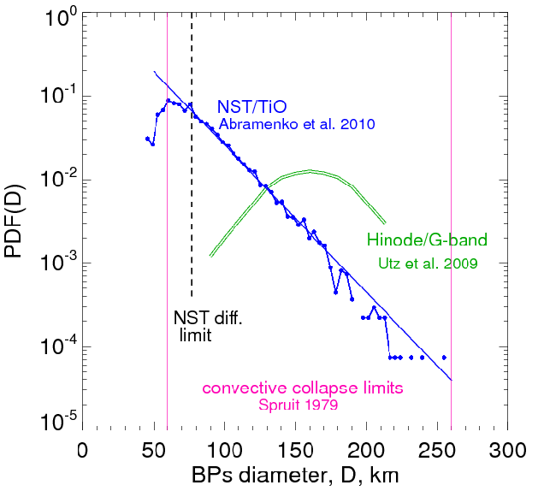
Size Distribution of BPs
7/05/2011
XXV IUGG/IAGA, Melbourne, Australia
Notes:
Convective collapse: Spruit states that After the collapse, the tubes with r>> 30 km enter a long period of quasi-static existence (when the upper layers are in temperature equilibrium while the deeper layers gradually heat up.) The convective collapse theory is applicable for the thin tube approximation, i.e., for tubes with r smaller than the temperature scale height, about 130 km for isothermal atmosphere on the low photospheric heights (0-500 km).

Slide 16


Diffusivity in the Photosphere
(x₀,y₀)
For each BP, we compute a set of
displacements from the start point:
(Δ l)²_{i} = (x_{i}-x_{o})²+(y_{i}-y₀)²
(x₁₀,y₁₀)
and a set of corresponding time delays:
(x_{N},y_{N})
Then for each
we average
displacements from all tracked BPs.
We thus obtain Displacement Spectrum:
Big Bear Solar Observatory
7/05/2011
XXV IUGG/IAGA, Melbourne, Australia
Notes:
16

Slide 17
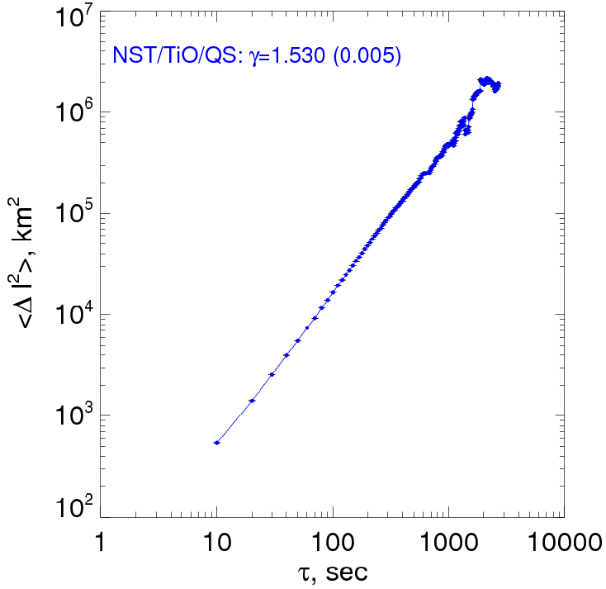
Diffusivity: Displacement Spectrum
7/05/2011
XXV IUGG/IAGA, Melbourne, Australia

Slide 18
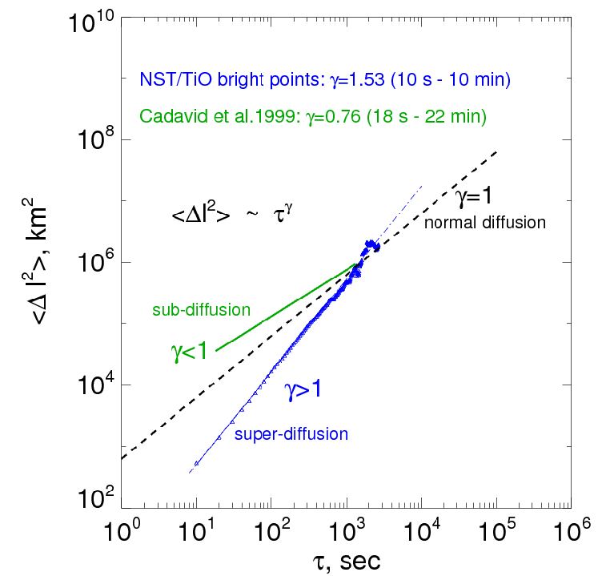
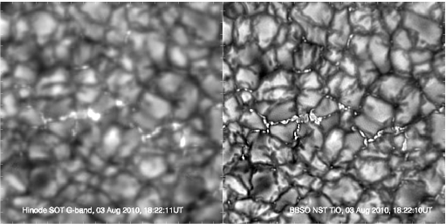
Slide Title Here
Manso Sainz+2011
Hinode SOT/SP
Big Bear Solar Observatory
7/05/2011
XXV IUGG/IAGA, Melbourne, Australia
Notes:
18

Slide 19
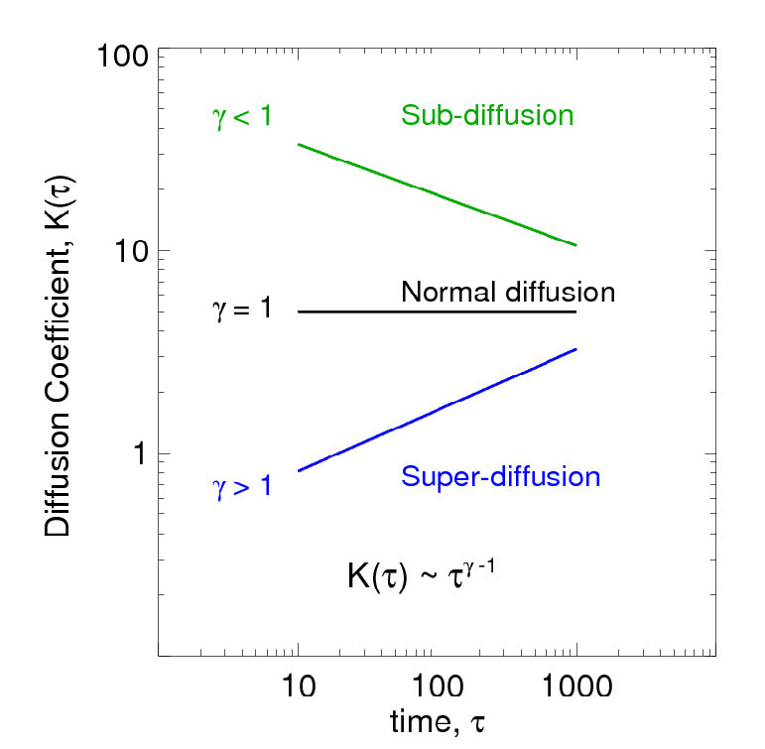
Diffusivity : Some Definitions
7/05/2011
XXV IUGG/IAGA, Melbourne, Australia

Slide 20
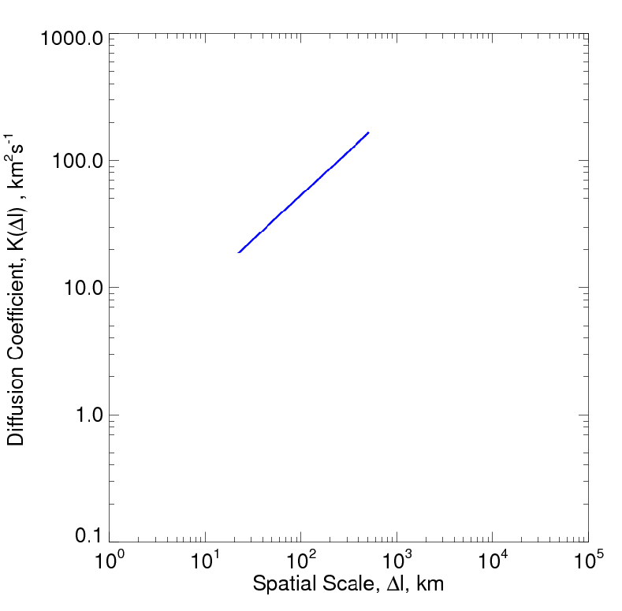
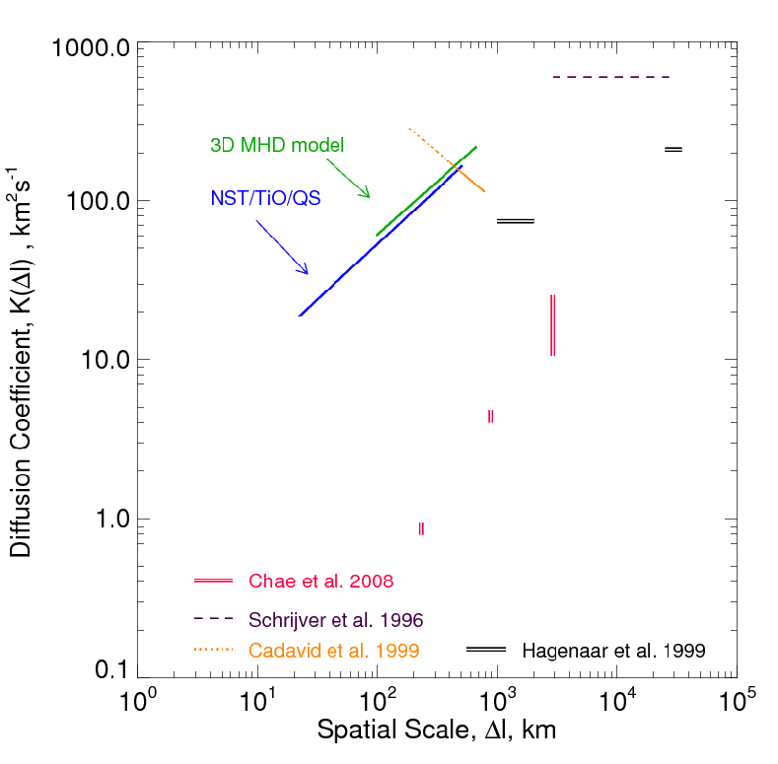
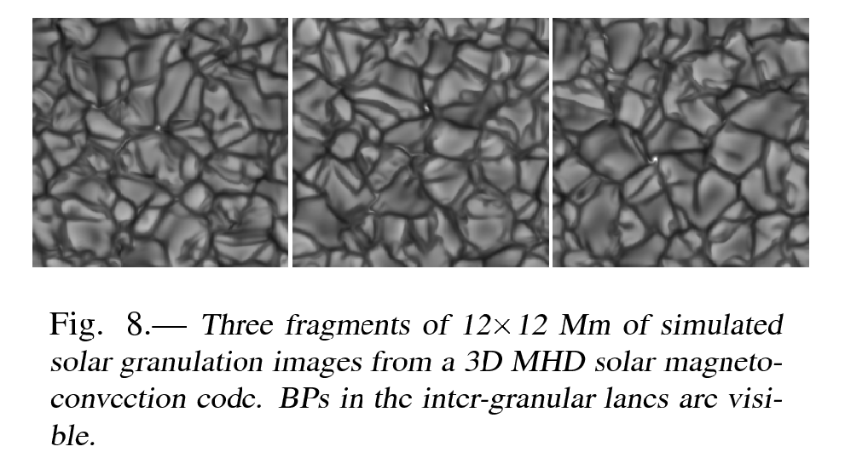
7/05/2011

Slide 21
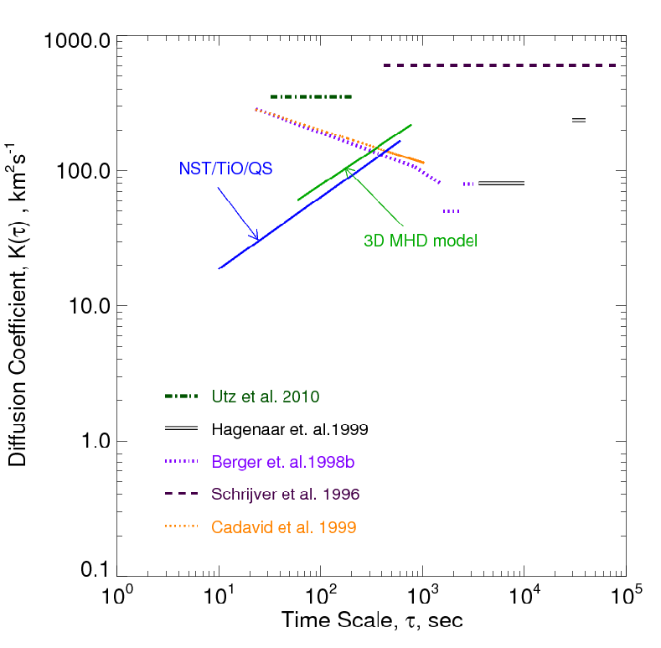
7/05/2011

Slide 22
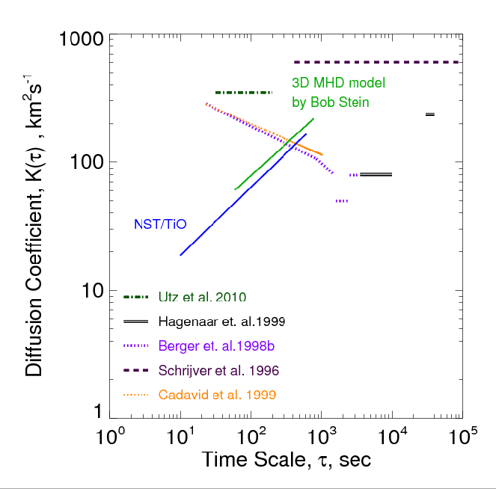
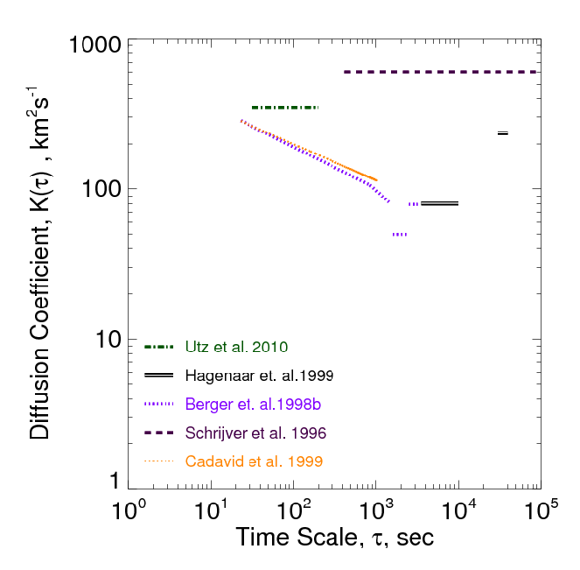
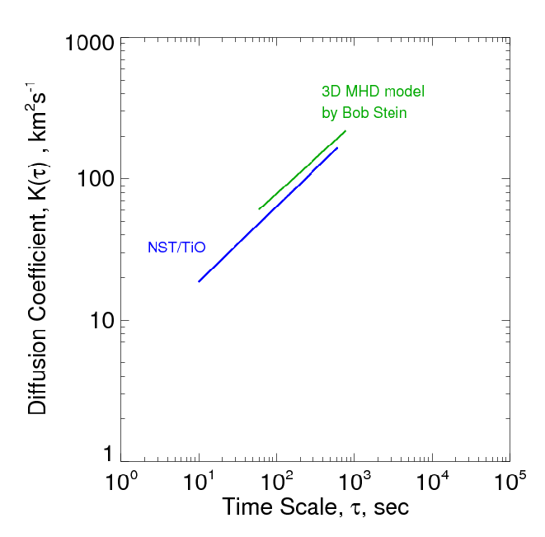
7/05/2011
XXV IUGG/IAGA, Melbourne, Australia
Notes:
So, decreasing diffusion coefficient on scales below 600 km indicates that ….

Slide 23
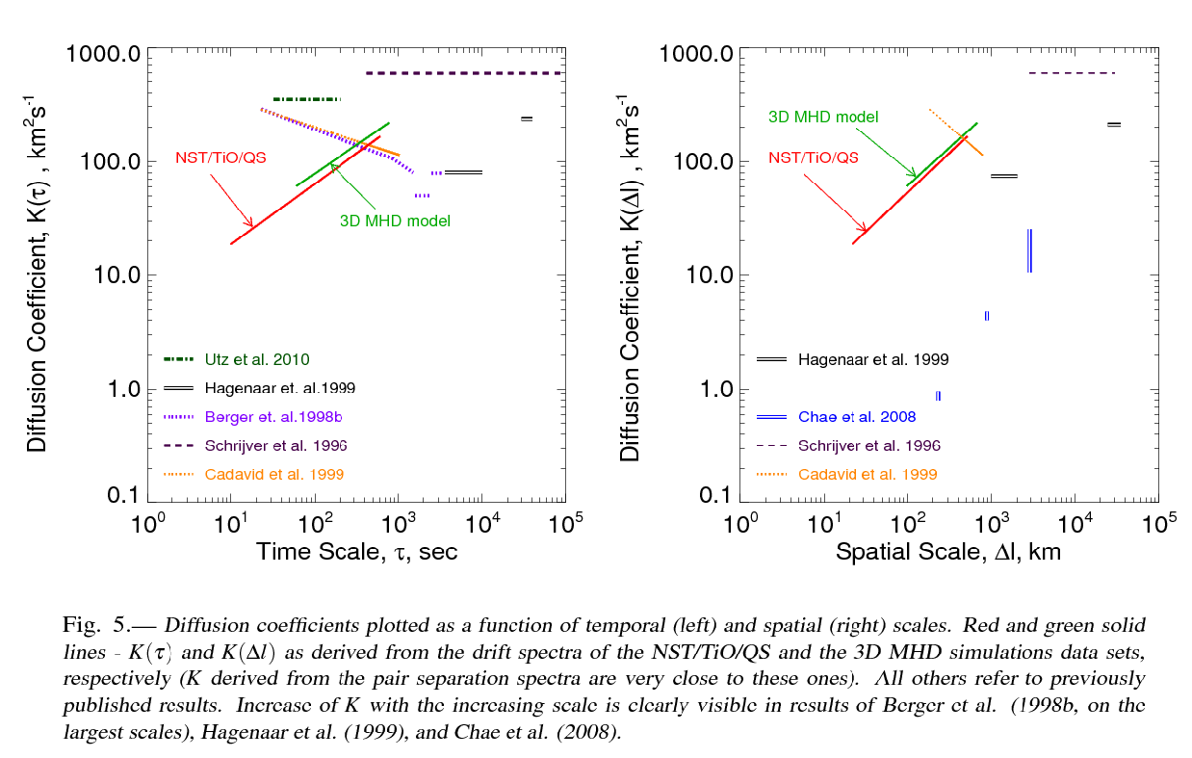
7/05/2011
XXV IUGG/IAGA, Melbourne, Australia

Slide 24
Kinetic and Magnetic Energy Spectra
λ_{η}
λ_{η}
7/05/2011
XXV IUGG/IAGA, Melbourne, Australia
Notes:
…. the magnetic turbulent dissipation scale is also rapidly decreasing parameter, and as we go to better resolution (smaller scales), we will get the magnetic spectrum with the cutoff shifted to the right (@)

Slide 25
Kinetic Spectrum
Power Spectrum
Magnetic Spectrum
Magnetic
Spectrum
Wavenumber
Spatial scale
λ _{η}
λ _{ν}
λ _{η}
Magnetic dissipation scales, λ _{η} ~ η^{3/4} = K^{3/4}
Magnetic dissipation scale is determined by the turbulent dissipation, so
When turbulent diffusion coefficient, K, decreases, λ _{η} will decrease too,
And the magnetic energy spectrum will be extended to the right (to small scales)
7/05/2011
XXV IUGG/IAGA, Melbourne, Australia
Notes:
….. the magnetic turbulent diss scale is also rapidly decreasing parameter, ensuring very comfortable conditions for SSTD action.

Slide 26
Conclusions
The tendency observed in the magnetic energy spectra and the regime of super-diffusivity on small scales indicated very favorable conditions for the small-scale turbulent dynamo action in the photosphere.
Big Bear Solar Observatory
7/05/2011
XXV IUGG/IAGA, Melbourne, Australia
Notes:
26

Slide 27
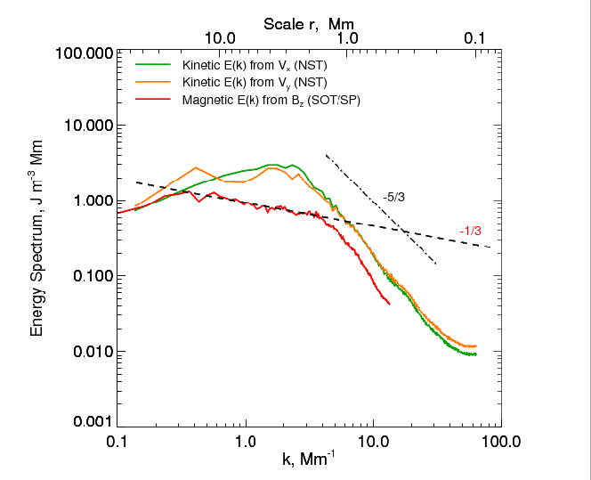
λ_{η}

